Slide 1
ICT Communications Lesson 5: Communicating Using Email

Slide 2
Objectives
2.5.1: Define "e-mail" and describe its functions and advantages as a form of communication.
2.5.2: Explain the format of an e-mail address (i.e., user name, @ symbol, domain).
2.5.3: Identify components of an e-mail message, including addresses (sender and recipients), subject, body, attachments, etc.
2.5.4: Perform e-mail activities (send, reply, forward) using an e-mail client and/or Web-based e‑mail.
2.5.5: Attach a file to an e-mail message.
2.5.6: Use an address book, a calendar and other features of an e-mail service.
2.5.7: Compose appropriate e-mail communications based on audience and purpose.
2.5.8: Demonstrate etiquette and safe practices when using e-mail.

Slide 3
Email
Allows you to send messages along with attachments quickly and easily via the Internet as long as all parties have an e-mail client (software).
Inbox, outbox, sent, and other folders in the e-mail client allow you to manage your e-mail messages and organize your e-mail client.
Email Clients: software program loaded on your computer used to send, receive and manage e-mail messages
Microsoft Outlook, Mozilla Thunderbird, Apple Mail
Web Based Email: Browser based email that is not downloaded to your PC. Accessed from anywhere you have an Internet connection
Web-based e-mail providers: Gmail, Yahoo, Hotmail, and Now Outlook.com

Slide 4
Contact Management
Address book: contains contact information for for people your contacts.
Calendar
To do list
Instant messaging: Similar to text messaging, both parties must be online

Slide 5
Email Address
Email address combines a user name and a domain name
student@school.edu
A unique combination of numbers and letters that identifies a particular user.
The user name must be different from any others within the same domain
Requires a password to login

Slide 6
Attachments
Files attached to an email that are sent via the email
Word-processing documents, spreadsheets, graphics, audio, video, links and other electronic files

Slide 7
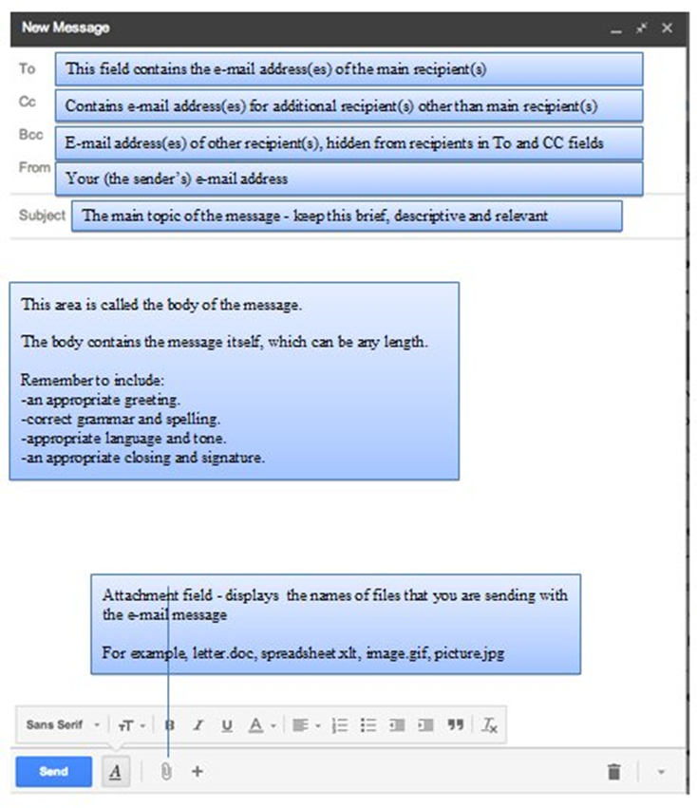
Parts of an Email

Slide 8
Email Netiquette (Professional Email)
Write with a respectful and restrained tone
Avoid using emoticons such as :-)
Do not use all capital letters
Avoid writing in a casual, joking style to convey a feeling of friendliness
Include a signature at end of message

